Slide 1
Knee Dislocation
Nyakure

Slide 2
Mechanism
Devastating injury resulting from high or low energy high-energy
usually from MVC or fall from height
commonly a dashboard injury resulting in axial load to flexed knee
low-energy
often from athletic injury
generally has a rotational component
morbid obesity is a risk-factor

Slide 3
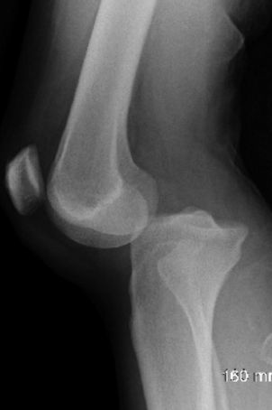
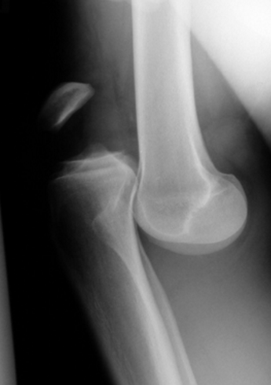
Images

Slide 4
Associated injuries
vascular injury
5-15% in all dislocations
40-50% in anterior/posterior dislocations
due to tethering at the popliteal fossa
proximal - fibrous tunnel at the adductor hiatus
distal - fibrous tunnel at soleus muscle
nerve injury
usually common peroneal nerve injury (25%)
tibial nerve injury is less common
fractures
present in 60%
tibia and femur most common

Slide 5
Descriptive classification
based on direction of displacement of the tibia
anterior
most common type of dislocation (30-50%)
due to hyperextension injury
usually involves tear of PCL
arterial injury is generally an intimal tear due to traction
posterior
2nd most common type (25%)
due to axial load to flexed knee (dashboard injury)
highest rate of complete tear of popliteal artery
lateral
13% of knee dislocations
due to varus or valgus force
usually involves tears of both ACL and PCL
highest rate of peroneal nerve injury
medial
varus or valgus force
usually disrupted PLC and PCL
rotational
posterolateral is most common rotational dislocation
usually irreducible

Slide 6
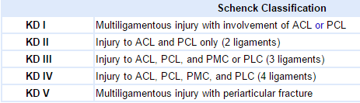
Schenck Classification
based on pattern of multiligamentous injury of knee dislocation (KD)

Slide 7
Clinicals
Symptoms
history of trauma and deformity of the knee
knee pain & instability
Physical exam
appearance
no obvious deformity
50% spontaneously reduce before arrival to ED (therefore underdiagnosed)
may present with subtle signs of trauma (swelling, effusion, abrasions)
obvious deformity
do not wait for radiographs, reduce immediately, especially if absent pulses
"dimple sign" - buttonholing of medial femoral condyle through medial capsule
indicative of an irreducible posterolateral dislocation
a contraindication to closed reduction due to risks of skin necrosis
stability
diagnosis based on instability on exam (radiographs and gross appearance may be normal)
may see recurvatum when held in extension
assess ACL, PCL, MCL, LCL, and PLC

Slide 8
Exam
vascular exam priority is to rule out vascular injury on exam both before and after reduction
serial examinations are mandatory
palpate the dorsalis pedis and posterior tibial pulses
if pulses are present and normal
does not indicate absence of arterial injury
collateral circulation can mask a complete popliteal artery occlusion
measure Ankle-Brachial Index (ABI)
if ABI >0.9
then monitor with serial examination (100% Negative Predictive Value)
if ABI <0.9
perform arterial duplex ultrasound or CT angiography
if arterial injury confirmed then consult vascular surgery
If pulses are absent or diminished
confirm that the knee joint is reduced or perform immediate reduction and reassessment
immediate surgical exploration if pulses are still absent following reduction
ischemia time >8 hours has amputation rates as high as 86%
if pulses present after reduction then measure ABI then consider observation vs. angiography

Slide 9
Imaging
Radiographs
may be normal if spontaneous reduction
look for asymmetric or irregular joint space
look for avulsion fxs (Segond sign - lateral tibial condyle avulsion fx)
osteochondral defects
MRI
required to evaluate soft tissue injury (ligaments, meniscus) and for surgical planning
obtain MRI after acute treatment

Slide 10
Initial Treatment
reduce knee and re-examine vascular status
considered an orthopedic emergency
splint knee in 20-30 degrees of flexion
confirm reduction is held with repeat radiographs in brace/splint
vascular consult indicated if
if arterial injury confirmed by arterial duplex ultrasound or CT angiography
pulses are absent or diminished following reduction

Slide 11
Nonoperative
indications
limited and most cases require surgical stabilization

Slide 12
Operative
emergent surgical intervention
indications
vascular injury repair (takes precedence)
open fx and open dislocation
irreducible dislocation
compartment syndrome
technique
vascular intervention
perform external fixation first
excision of damaged segment and repair with reverse saphenous vein graft
always perform fasciotomies after vascular repair

Slide 13
delayed ligament reconstruction or repair
indications
instability requires ligament repair or fixation
knee immobilizer for 6 weeks before repair
improved outcomes with early treatment (within 3 weeks)
technique
PLC
recommend early reconstitution
PCL
reconstruct prior to ACL reconstruction
postoperative
recommend early mobilization and functional bracing

Slide 14
Complications
Stiffness (arthrofibrosis)
is most common complication
more common with delayed mobilization
Laxity and instability
Peroneal nerve injury
most common in posterolateral dislocations
poor results with acute, subacute, and delayed (>3 months) nerve exploration
neurolysis and tendon transfers are the mainstay of treatment
Vascular compromise
in addition to vessel damage, claudication, skin changes, and muscle atrophy can occur

